Slide 1
Progress Report Hind Alzaabi

Slide 2
Literature review
Reviewed papers:
Deep Compression
Distilling the Knowledge in a Neural Network
MobileNet
EfficientNet
MCUNet

Slide 3
dataset
BCI Competition 2008 – Graz data set A
9 subjects, 22 Channels, 1001 samples (250 Hz, 4 seconds of data)
576 trials (12 trials per class, 4 classes per run, 6 runs, 2 sessions)
Files separated into data, labels, and metadata for each subject
Data saved per subject (trials x channels x samples)
Tasks: left hand, right hand, feet, tongue

Slide 4
Week 3
Simple NN model:
Created using Pytorch
3 Blocks of 2D convolutions and MaxPooling
Worst performing accuracy, only slightly higher than chance (25%)
Imported EEGNet Model:
Imported from GitHub
Written in Keras
Training took the longest

Slide 5
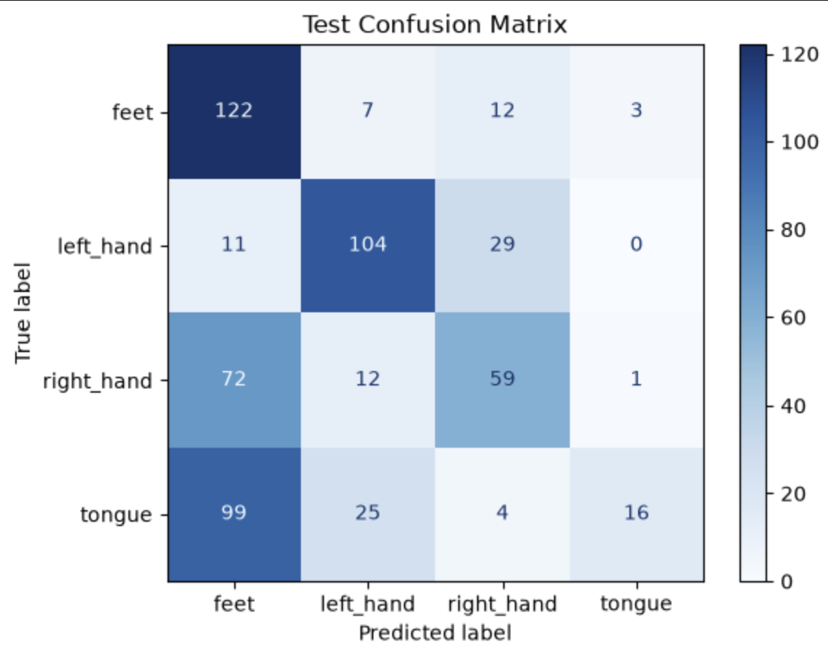
Week 3
EEGNet converted to Pytorch
Similar accuracy to the Keras model
However, significantly faster

Slide 6
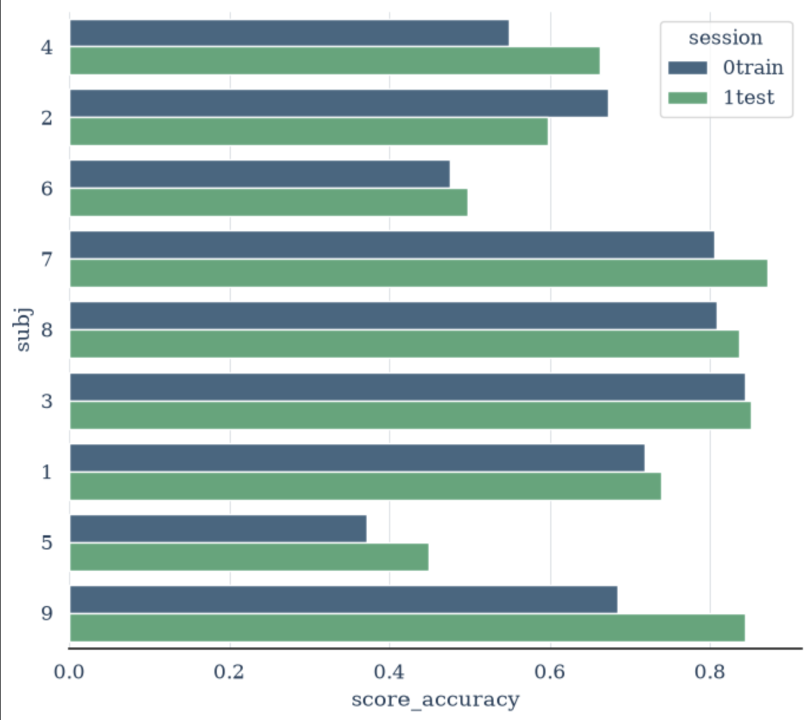
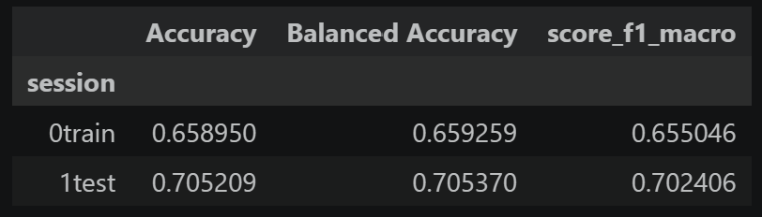
Week 3
Simple CSP + LDA model:
Created using the MOABB library
Best performance and fastest training

Slide 7
baselines
Model | Accuracy
Simple CNN | 31.4%
EEGNet (Keras) | 51.4%
EEGNet (Pytorch) | 52.26%
CSP + LDA | 70.5%

Slide 8
Robustness experiments
Experiments:
Missing channels
Scaling
Gaussian noise
Missing durations
Missing frequency bands

Slide 9
Robustness experiments
Methodology:
For each condition, model was evaluated across multiple parameter values
Randomized each condition, repeated multiple times, and averaged results
Three cases were tested:
Both train and test datasets were preprocessed
Train only preprocessed
Test only preprocessed
Per subject K-fold evaluation
Performance calculated using accuracy

Slide 10
Both train and test preprocessed

Slide 11
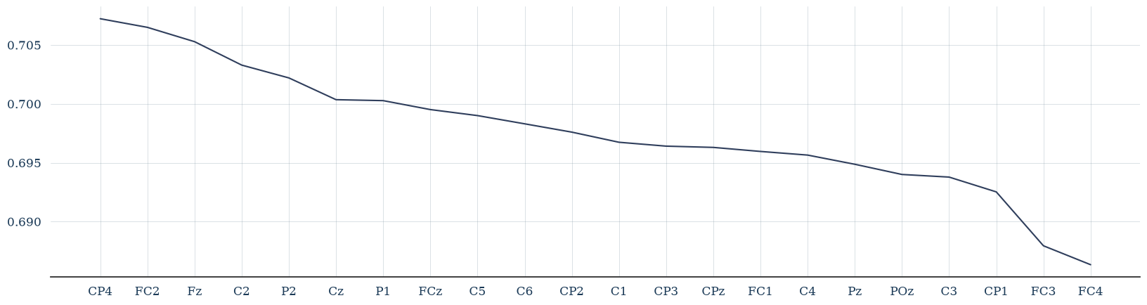





Missing channels
Test accuracy: 68.5%
Fronto-Central: Motor planning , cognitive control, and executive function

Slide 12
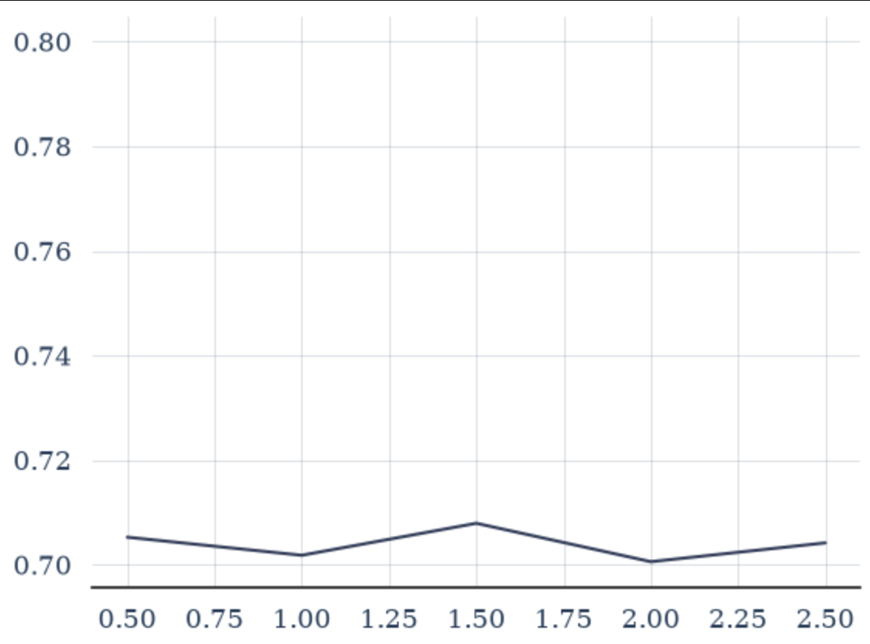
scaling
Test accuracy: 70.5%

Slide 13
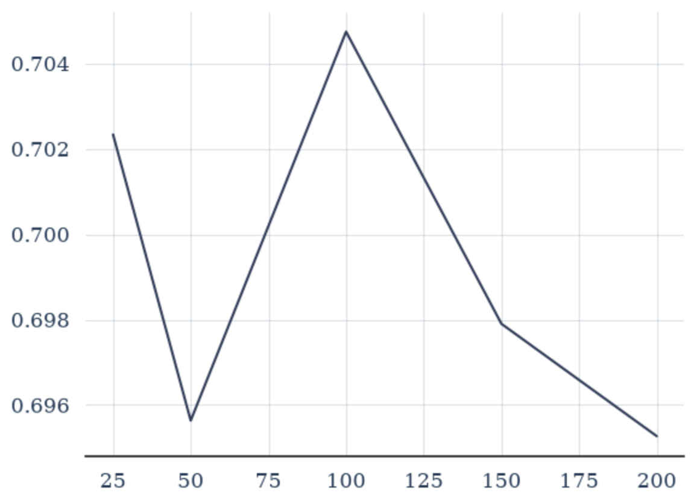
Missing durations
Test accuracy: 69.9%

Slide 14
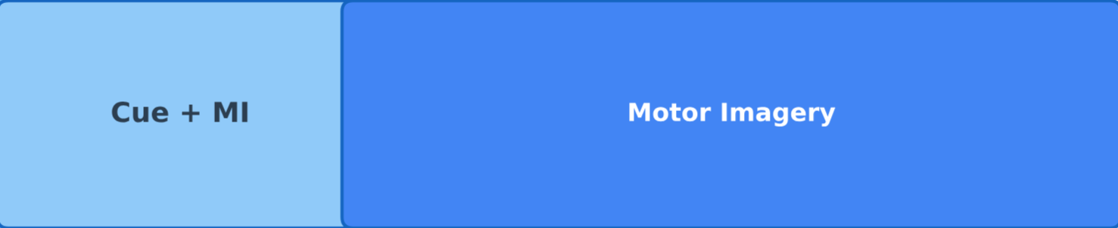
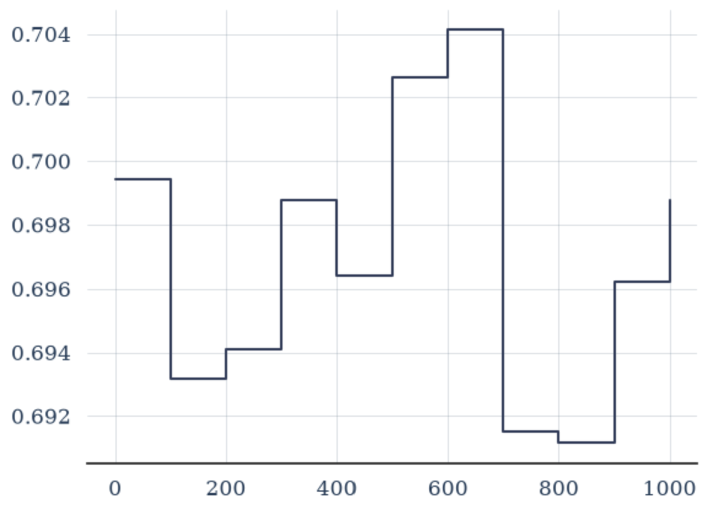
Missing durations
Removed 100 durations from FC3 and FC4

Slide 15
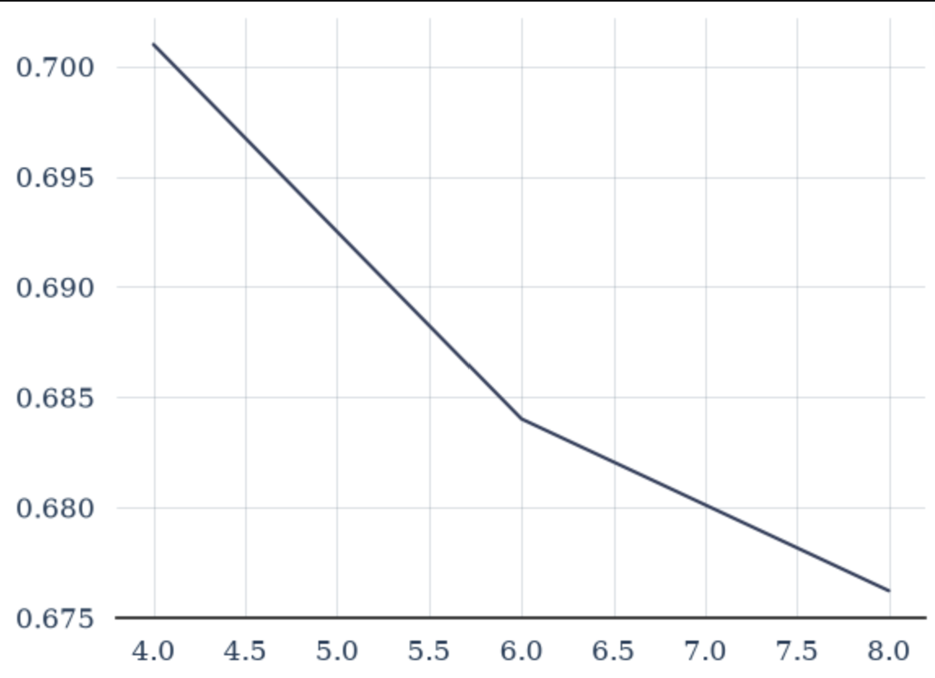
Missing frequencies
Test accuracy: 68.7%

Slide 16
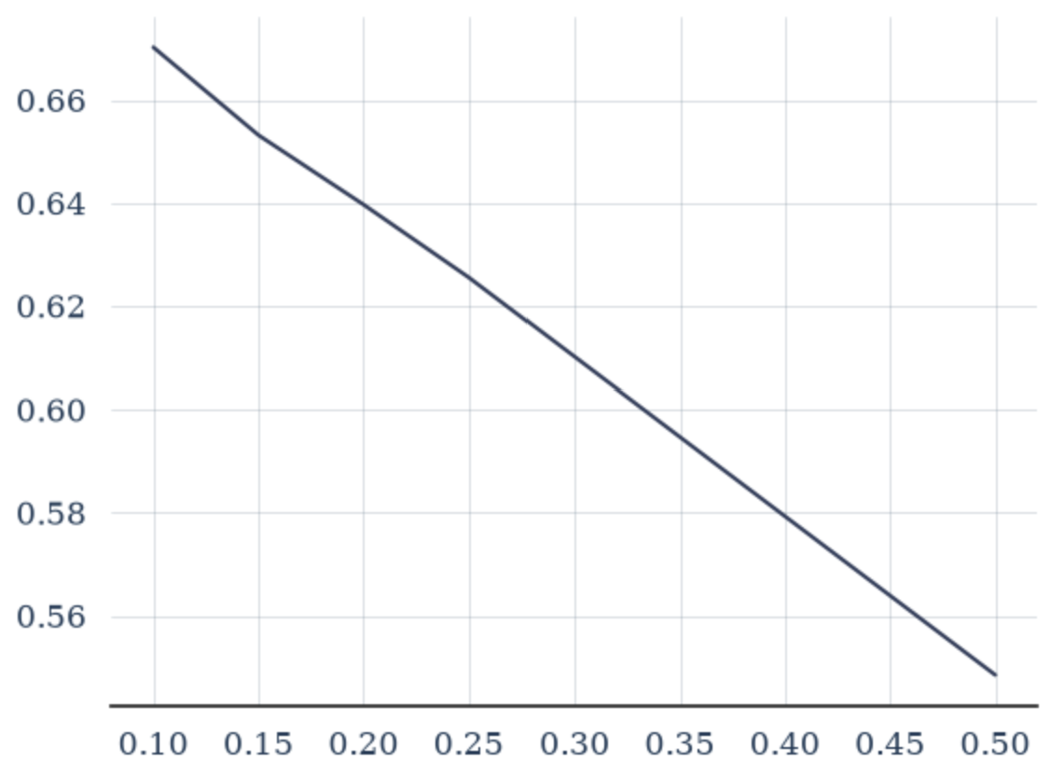
Gaussian noise
Test accuracy: 62.7%

Slide 17
Robustness experiments
Condition | Accuracy
Baseline | 70.5%
Scaling | 70.5%
Missing durations | 69.9%
Missing frequencies | 68.7%
Missing data | 68.5%
Noise | 62.7%

Slide 18
train and test alone

Slide 19
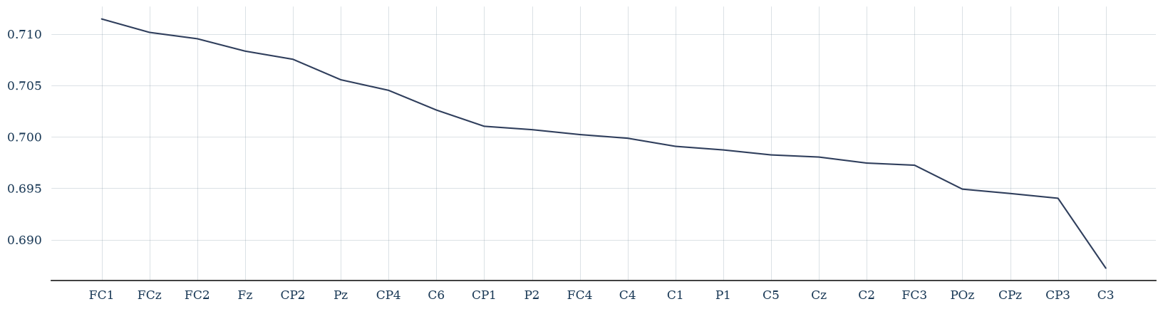
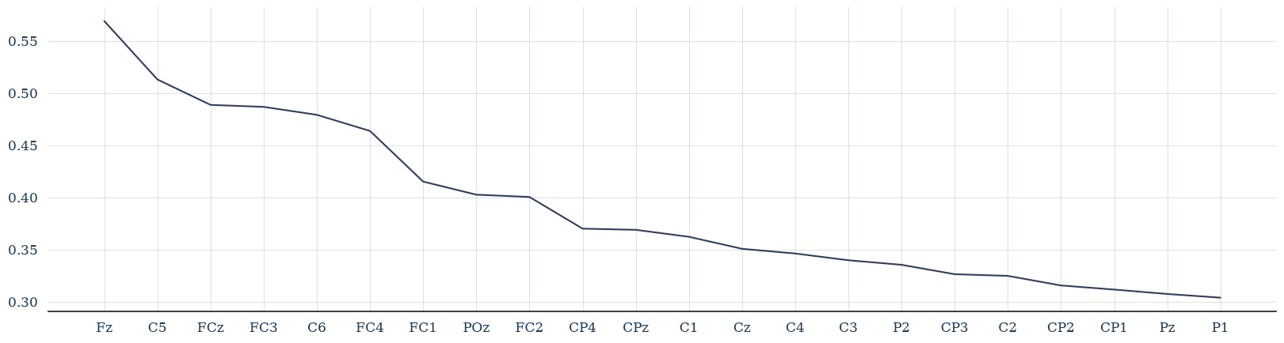
Missing channels
Train only preprocessed:
Test only preprocessed:

Slide 20
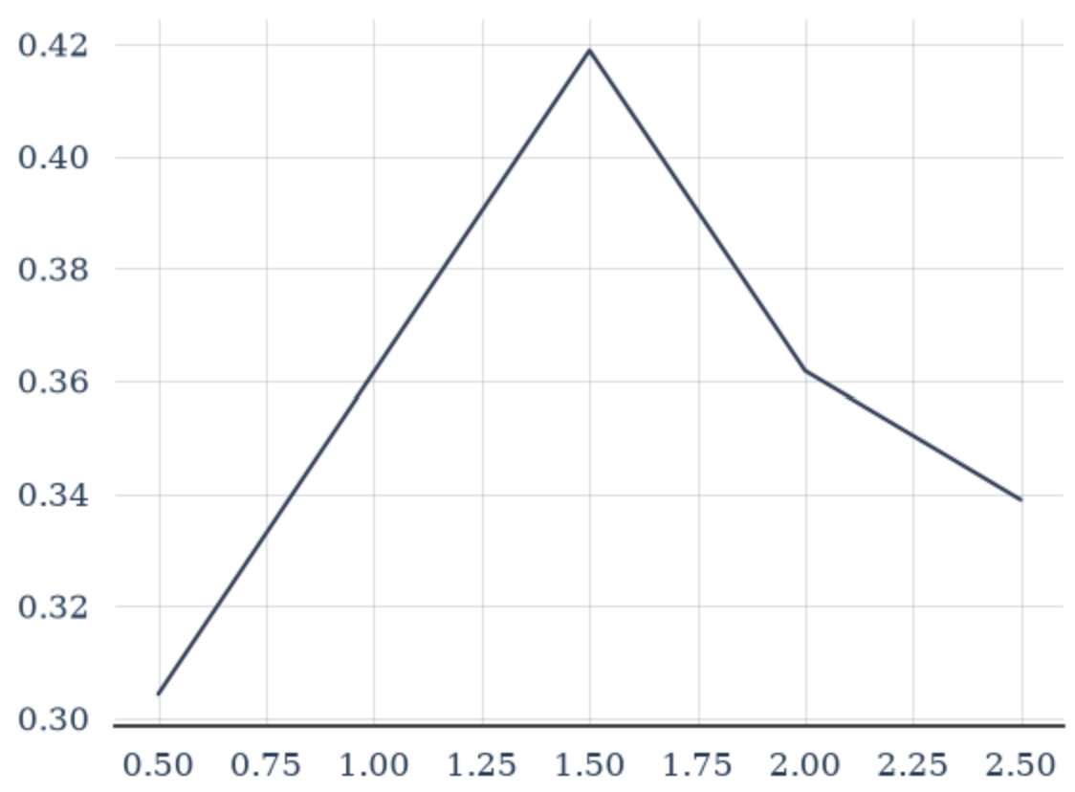
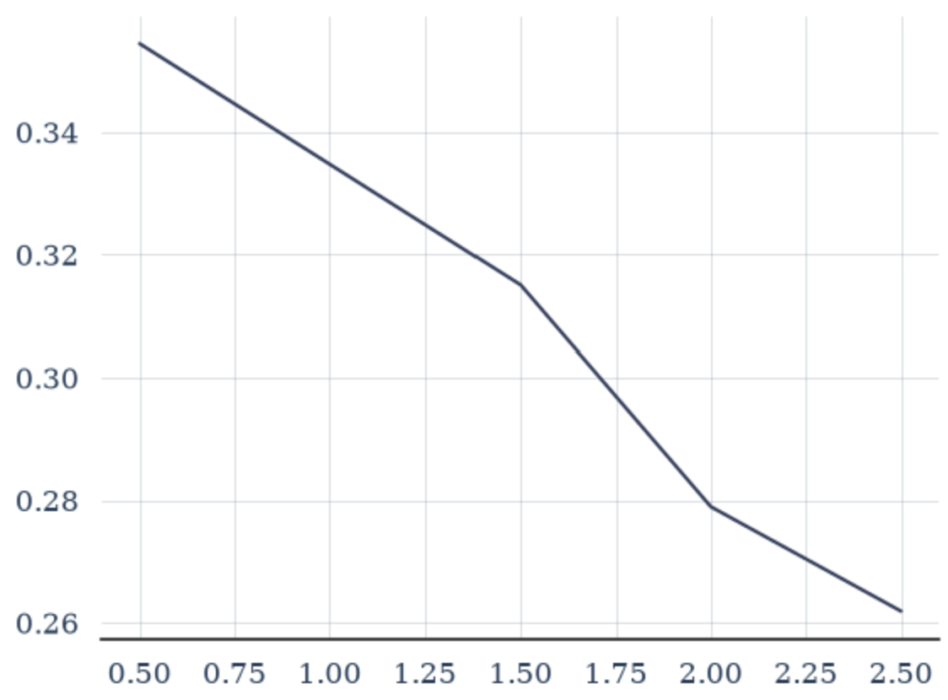
scaling
Both preprocessed
Train preprocessed
Test preprocessed

Slide 21
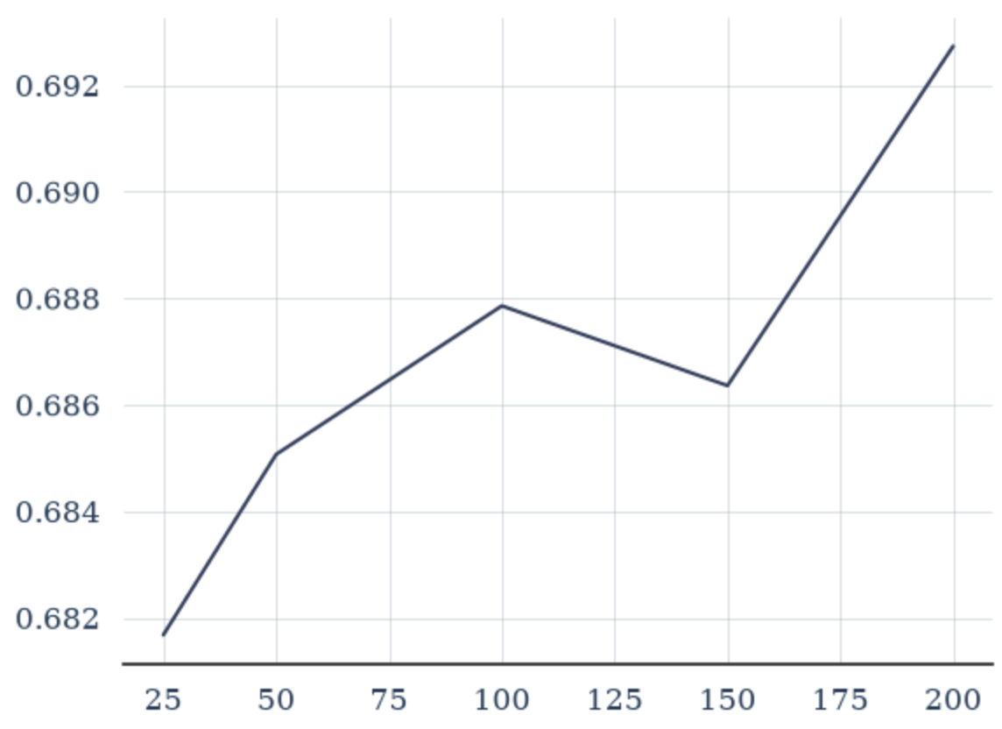
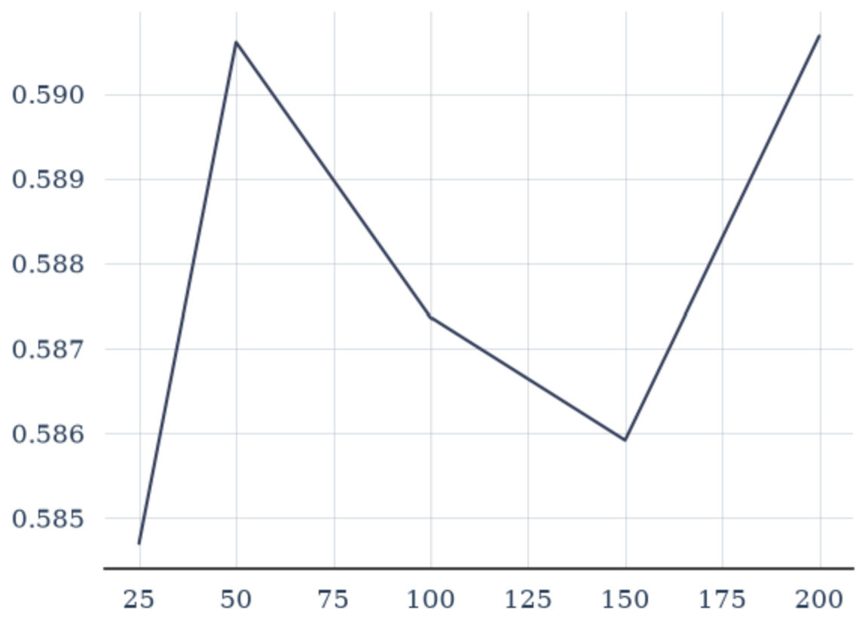
Missing durations
Both preprocessed
Train preprocessed
Test preprocessed

Slide 22
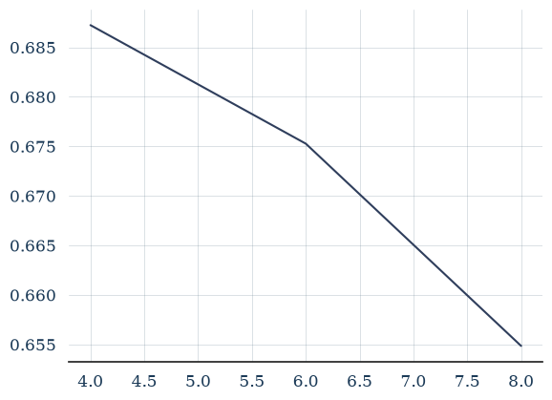
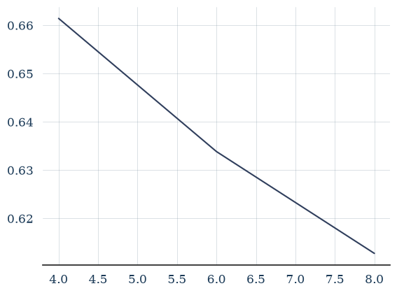
Missing frequencies
Both preprocessed
Train preprocessed
Test preprocessed

Slide 23
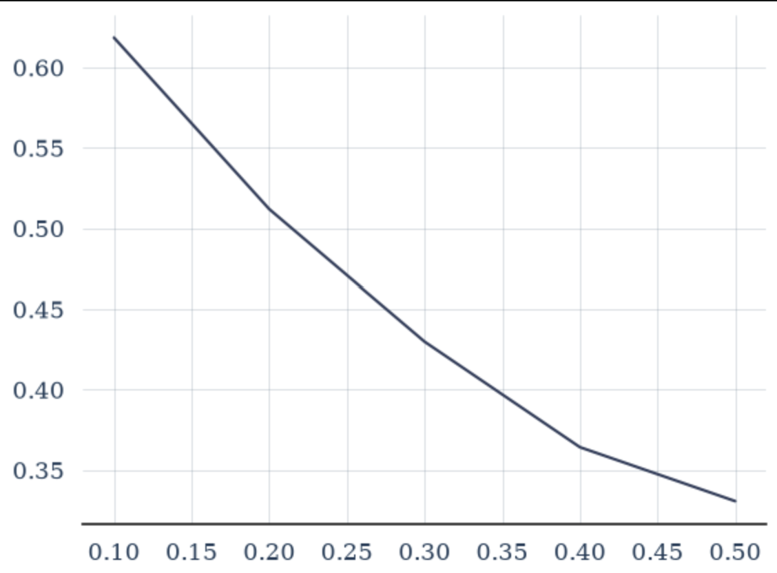
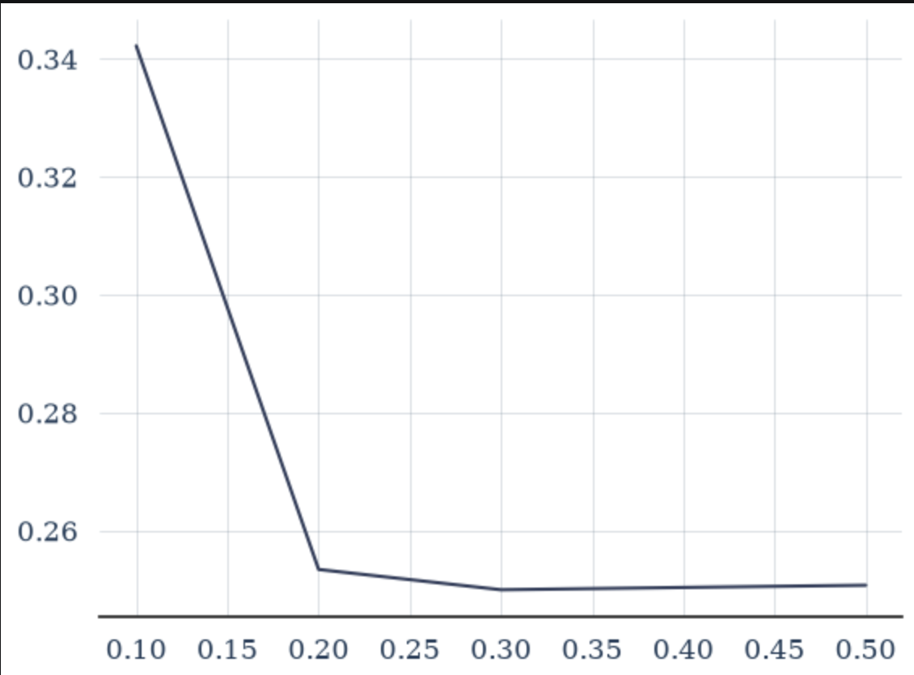
Added noise
Both preprocessed
Train preprocessed
Test preprocessed

Slide 24
Robustness experiments
Condition | Train only | Test only
Baseline | 70.5% | 70.5%
Scaling | 35.6% | 30.3%
Missing durations | 68.7% | 58.8%
Missing frequencies | 67.3% | 63.5%
Missing data | 70.1% | 39.0%
Noise | 45.1% | 26.9%
Notes:
Best results when both the same
Scaling: highly sensitive
missing duration experiment: stable
missing frequencies: accuracy 6 Hz informative
missing data: robust during training, not during testing
noise experiment: gradually reduced accuracy. However, sharp when alone

